Slide 1

Using Big Data to Understand Subglacial Features
Team name: Avengers

Slide 2
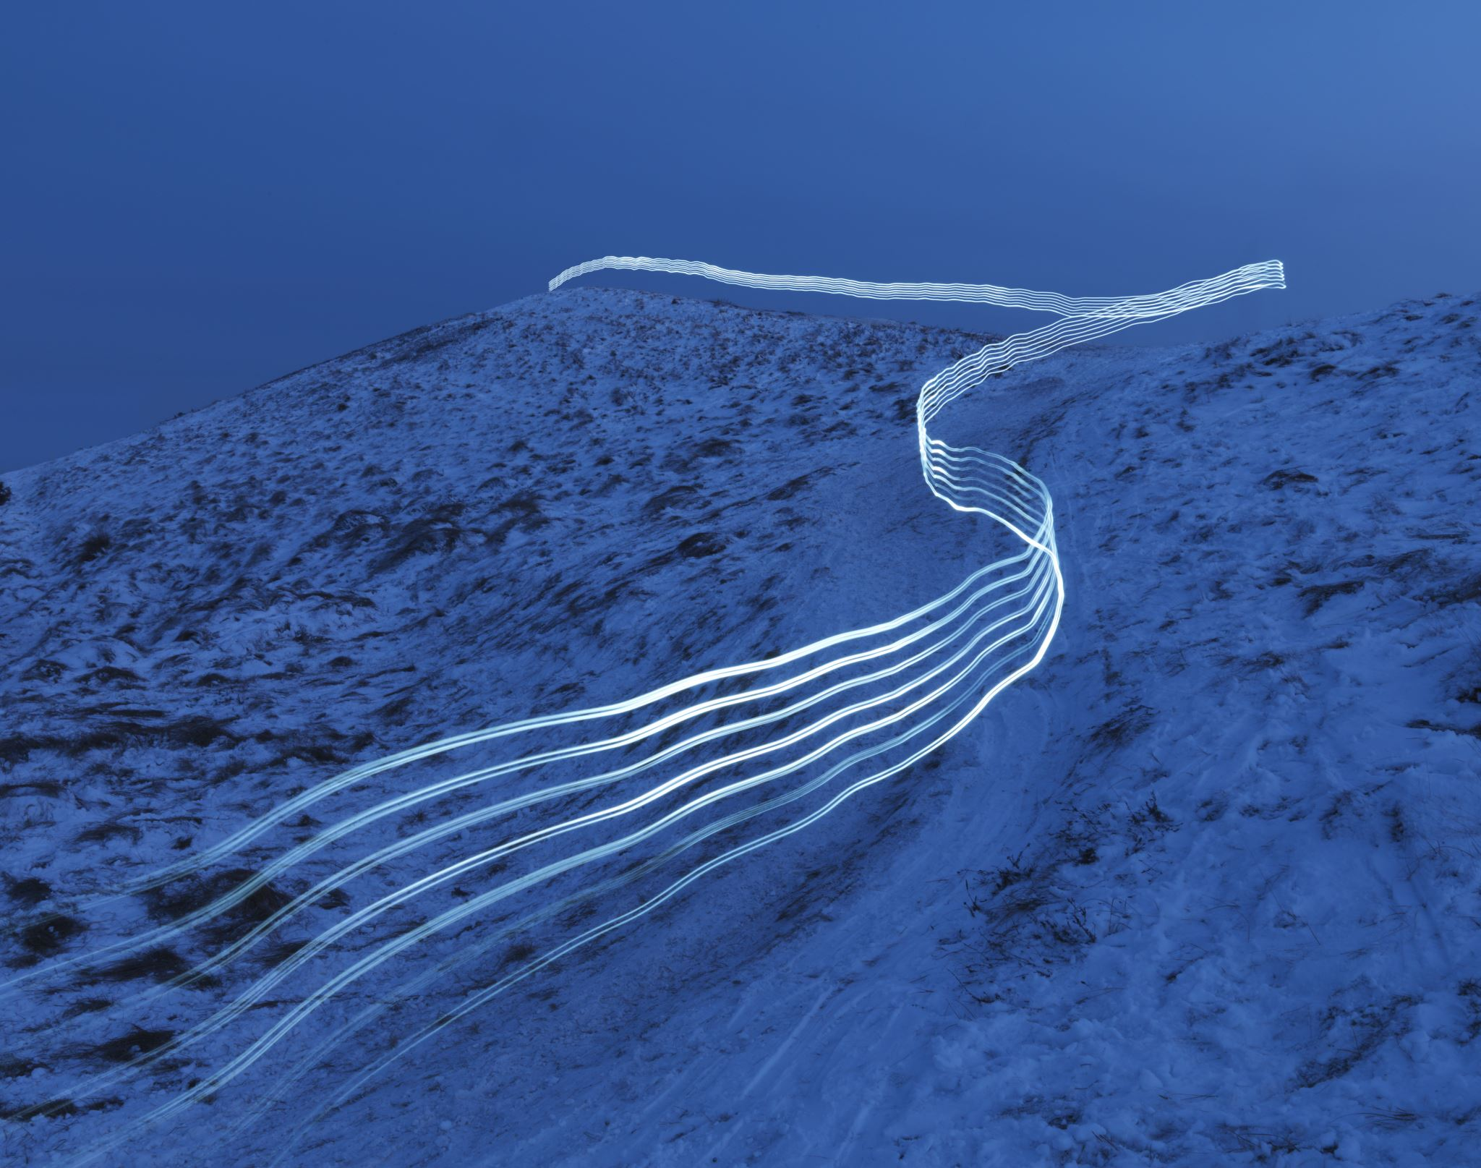
Project Overview:
This project benchmarks XGBoost model performance in predicting subglacial bed elevation using three computing platforms: Local, Dask, and PySpark. The goal is to assess runtime efficiency, scalability, and model accuracy across different distributed environments on the Taki HPC cluster.

Slide 3
Why This Matters
Subglacial bed prediction is computationally intensive due to large, high-resolution datasets.
Distributed ML platforms like Dask and PySpark offer scalable solutions — but differ in setup, performance, and usability.
Understanding the trade-offs in speed, accuracy, and scalability is critical for selecting the right tool for HPC or cloud environments.
This study benchmarks Local XGBoost, Dask, and PySpark to inform model deployment decisions in real-world geospatial prediction tasks.

Slide 4

Data Description
Source: Radar and satellite data from Greenland (ICMLA 2023 study)
Size: ~632,706 observations (track and surface data)
Variables:
track_bed_target (true bed elevation)
Surface variables: surf_elv, surf_vx, surf_vy, surf_dhdt, surf_SMB

Slide 5
Methods So Far
Preprocessed Greenland surface dataset (vx, vy, SMB, elevation, etc.)
Engineered velocity magnitude feature
Trained XGBoost models:
Locally (single-threaded)
Dask (single-node & multi-node via SLURM)
PySpark GBTRegressor (distributed Spark)
Evaluated using RMSE, MAE, and R²
Benchmarked training time for each platform

Slide 6
Why We Used Dask?
Python-Native Integration:
Dask works natively with Python tools like NumPy, pandas, and XGBoost, enabling seamless development in a familiar ecosystem.
Flexible Cluster Execution:
Dask integrates easily with SLURM (used on Taki), allowing both single-node and multi-node execution without complex Spark setups.
Lower Overhead for Medium Data:
Ideal for medium-scale datasets (~100MB–100GB), where Dask avoids the heavyweight JVM dependencies of Spark.
Scalability with Minimal Code Change:
The same code can scale from a laptop to a supercomputer with just a change in the cluster setup — no API rewrites are needed.
Notes:
Dask was the most efficient and practical framework for running XGBoost on HPC infrastructure (Taki) under a SLURM environment.

Slide 7
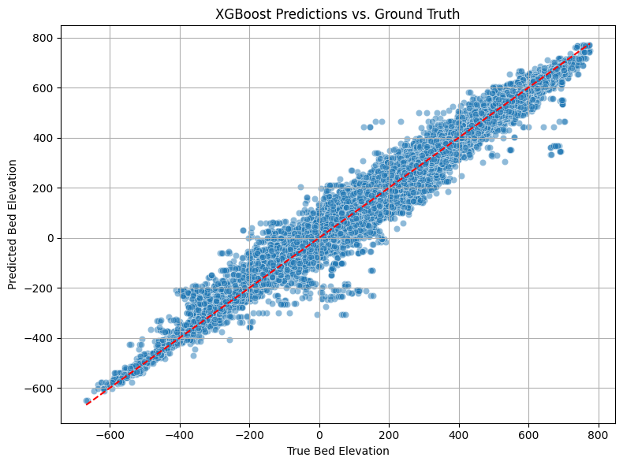
Plots for local:

Slide 8
Plots for DASK:

Slide 9
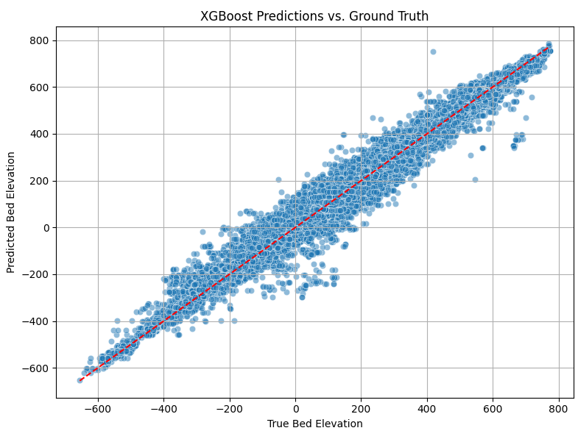
Plots for PySpark:

Slide 10

Midway Results
Local XGBoost gives the best accuracy but is slow for large-scale runs
Dask enables easier transition from local to cluster runs with minimal code changes
PySpark shows better runtime on multi-node setups but requires extra configuration
Prediction accuracy is consistent across platforms, but performance varies with data size and cluster resources

Slide 11
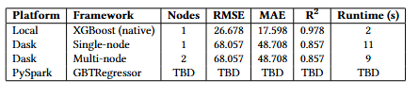
Midway Results Tables

Slide 12
Next Steps
Complete benchmarking on larger synthetic datasets
Compare resource utilization across platforms
Summarize trade-offs between speed, accuracy, and scalability
Prepare reproducibility instructions for deployment on SLURM

Slide 13

Challenges
Installing and managing Python packages in HPC (virtualenvs)
Handling SLURM-based Dask setup (__main__ guard, spawn method)
Diagnosing inconsistent performance across single-node vs. multi-node Dask
PySpark GBTRegressor setup requires additional configuration (JARs, version sync)
Logging and measuring runtime across distributed platforms in a reproducible manner
Ensuring identical preprocessing across Local, Dask, and PySpark models for fair comparison

Slide 14
References
Katherine Yi, Angelina Dewar, Tartela Tabassum, Jason Lu, Ray Chen,Homayra Alam, Omar Faruque, Sikan Li, Mathieu Morlighem, and Jianwu Wang. Evaluating machine learning and statistical models for Greenland subglacial bed topography. In 2023 International Conference on Machine Learning and Applications (ICMLA), pages 659–666, 2023.
Tianqi Chen and Carlos Guestrin. Xgboost: A scalable tree boosting system. In Proceedings of the 22nd ACM SIGKDD International Conference on Knowledge Discovery and Data Mining, KDD ’16, page785–794. ACM, August 2016.
Github repository for predicting ice-bed topography using predictive modeling.” https://github.com/big-data-lab-umbc/big-data-reu/tree/main/2023-projects/team-1, [Online; Accessed: 2023-07-30 ].

Slide 15
Q&A

Slide 16
Thank you!

